Slide 1


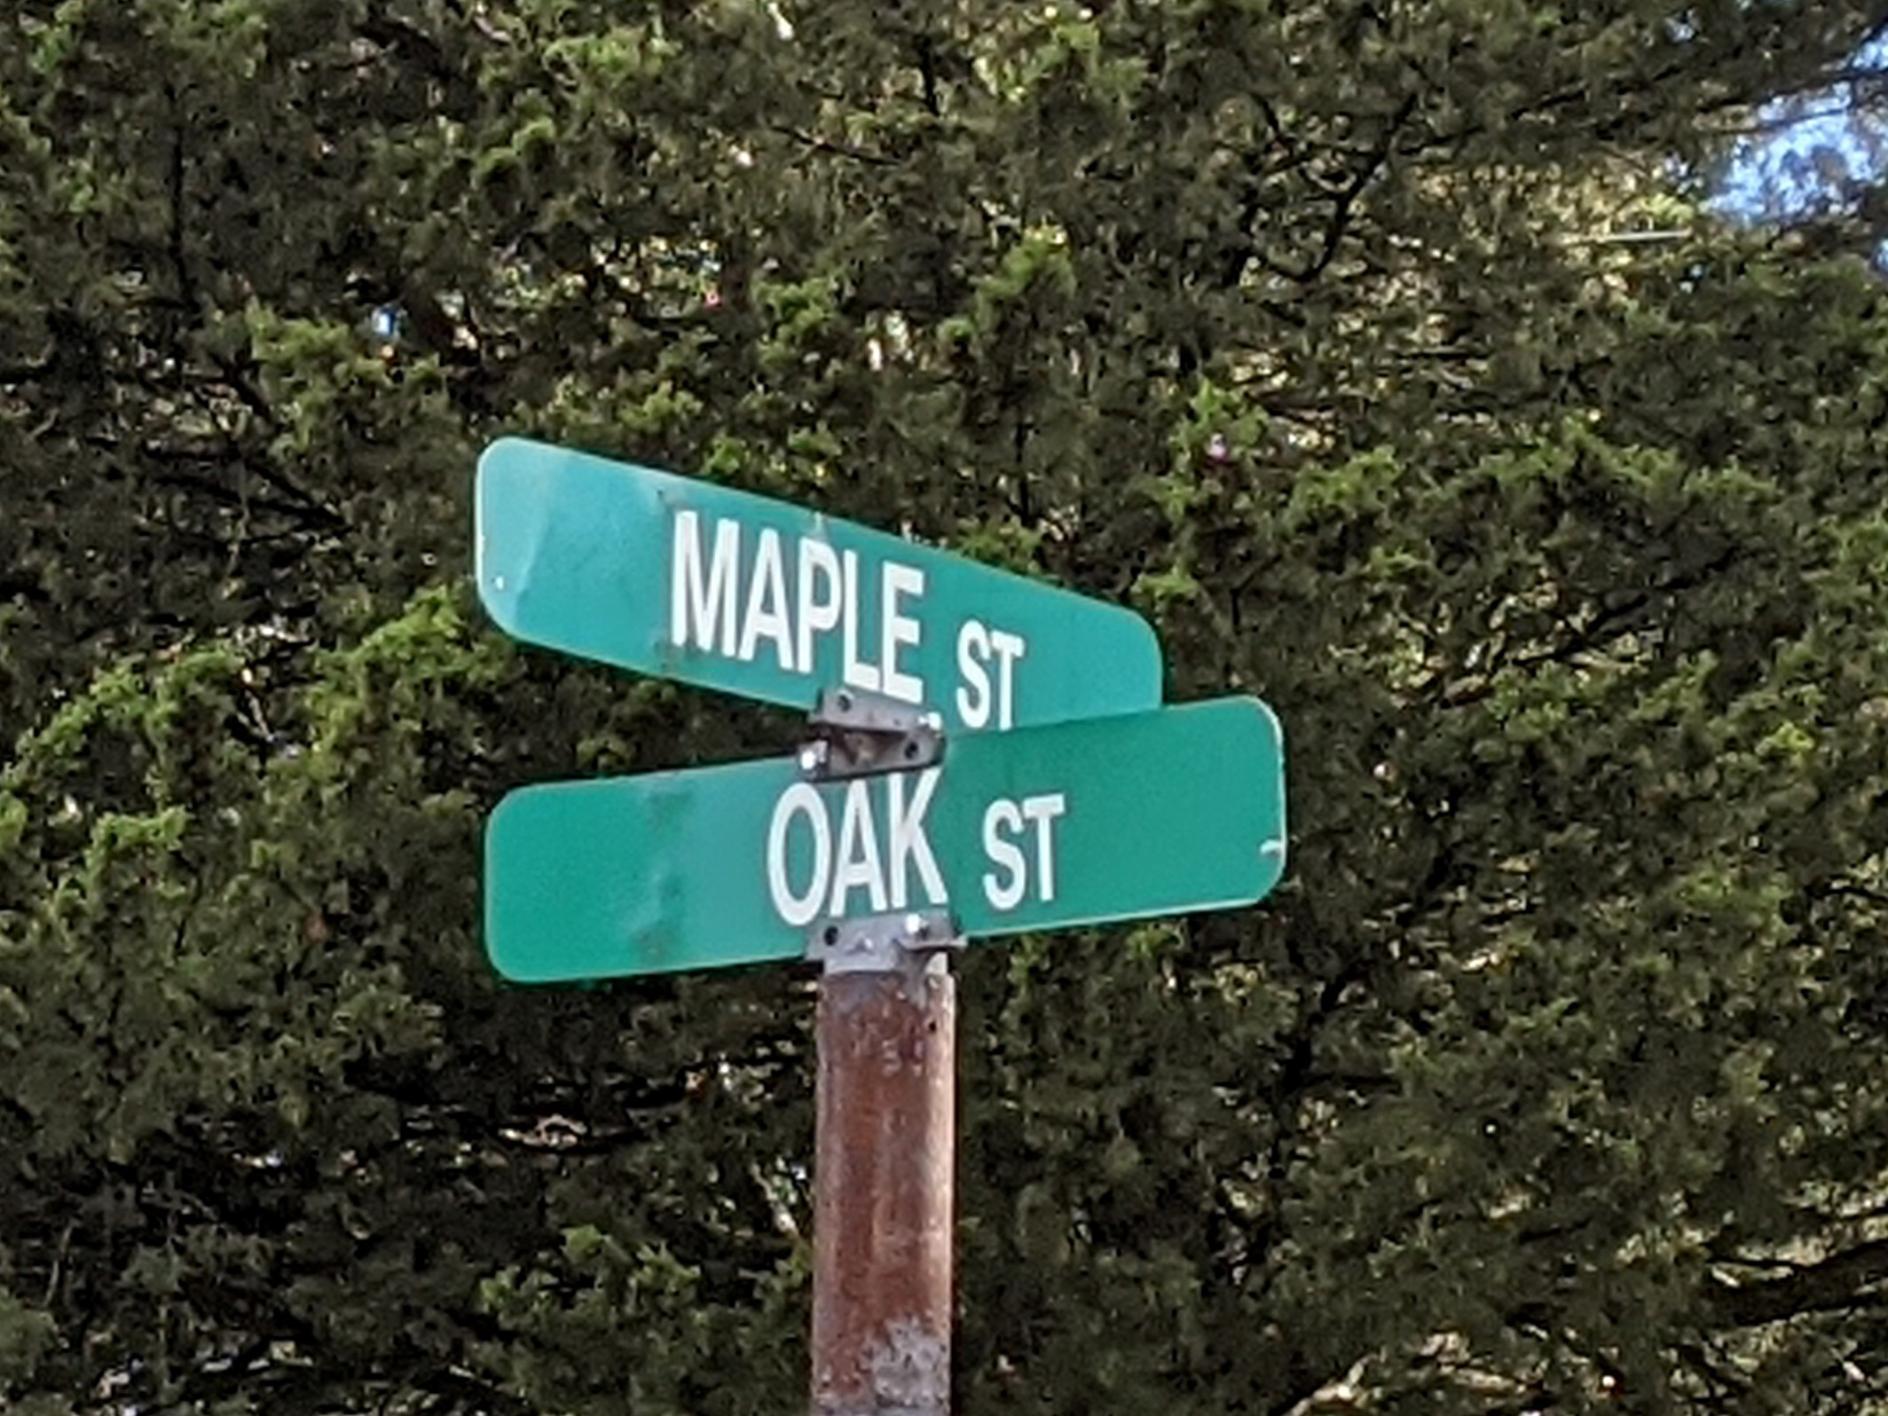
Maple and Oak
Building a deep learning binary classifier

Slide 2
Presentation Outline
Problem
Model and Data
Results
Recommendations and Future Work

Slide 3
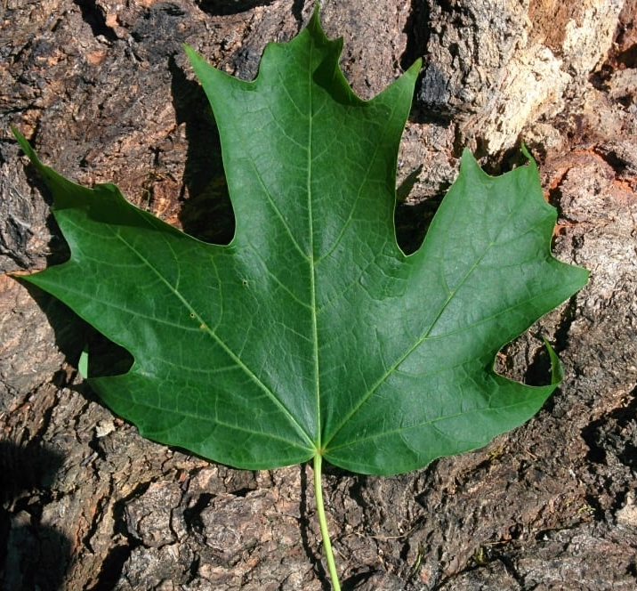
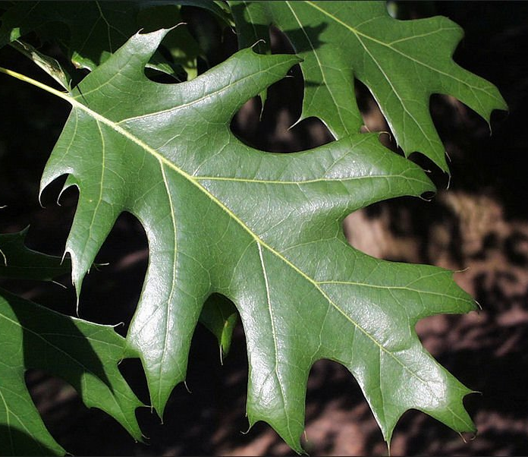
Problem
Identify a leaf as oak or maple with a picture
Notes:
A clear explanation of the problem, context, success metrics, stakeholders, and constraints. (1-2 slides)

Slide 4
Problem
… as accurately as a human (or better)
Notes:
A clear explanation of the problem, context, success metrics, stakeholders, and constraints. (1-2 slides)

Slide 5
Who cares?
Many individuals want to be able to identify trees:
Park visitors
Park maintenance/Forestry
Environmental groups
Notes:
A clear explanation of the problem, context, success metrics, stakeholders, and constraints. (1-2 slides)

Slide 6
Who cares?
… and some want to be able to do it remotely and automatically
Notes:
A clear explanation of the problem, context, success metrics, stakeholders, and constraints. (1-2 slides)

Slide 7
Constraints
Simple binary problem
No species level distinction
Only green-leafed “normal” leaves
Video only taken up-close (within 5 feet)

Slide 8
Presentation Outline
Problem
Model and Data
Results
Recommendations and Future Work

Slide 9
Modeling
Convolutional Neural Network
Pre-trained model adopted
7000 color images
Notes:
Modeling (e.g. machine learning) at a high level (i.e. What method did you choose and why?) (1-2 slides)

Slide 10
Data
Cell phone video
~8 videos each of maple/oak (~1 min each)
Notes:
The formulation of the project as a data science problem and a description of the dataset (1-2 slides)

Slide 11
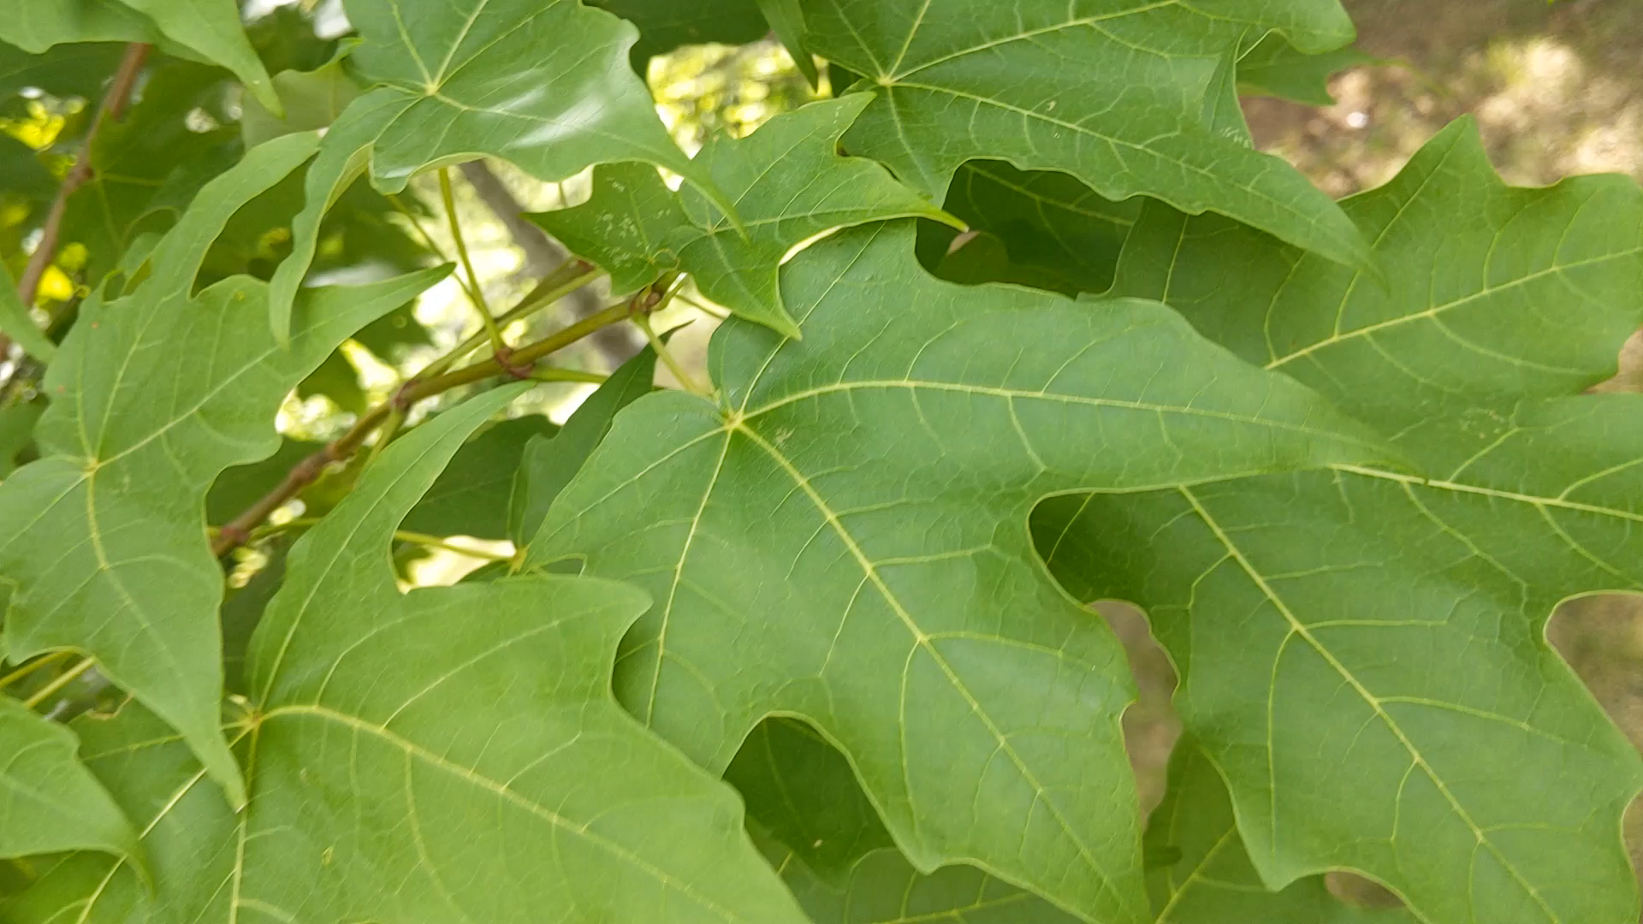
Data
Notes:
The formulation of the project as a data science problem and a description of the dataset (1-2 slides)

Slide 12
Data
Image extraction
Every 10 frames
= 3 images per second
Notes:
The formulation of the project as a data science problem and a description of the dataset (1-2 slides)

Slide 13
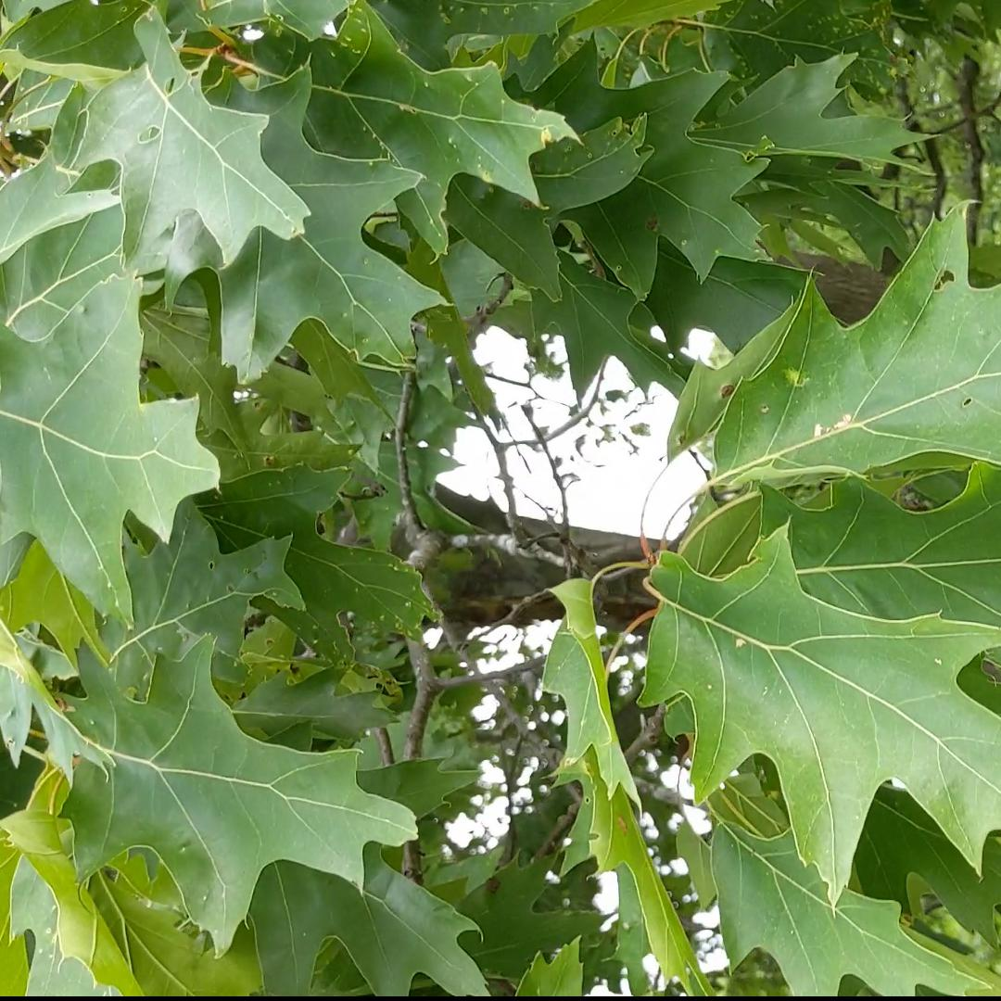
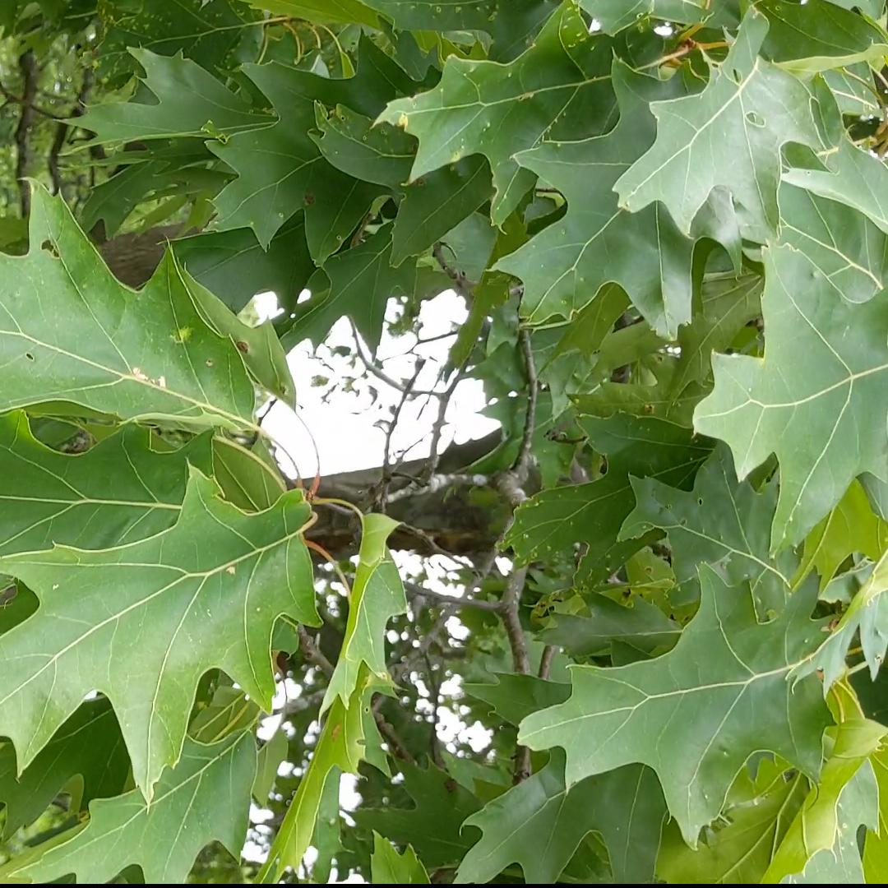
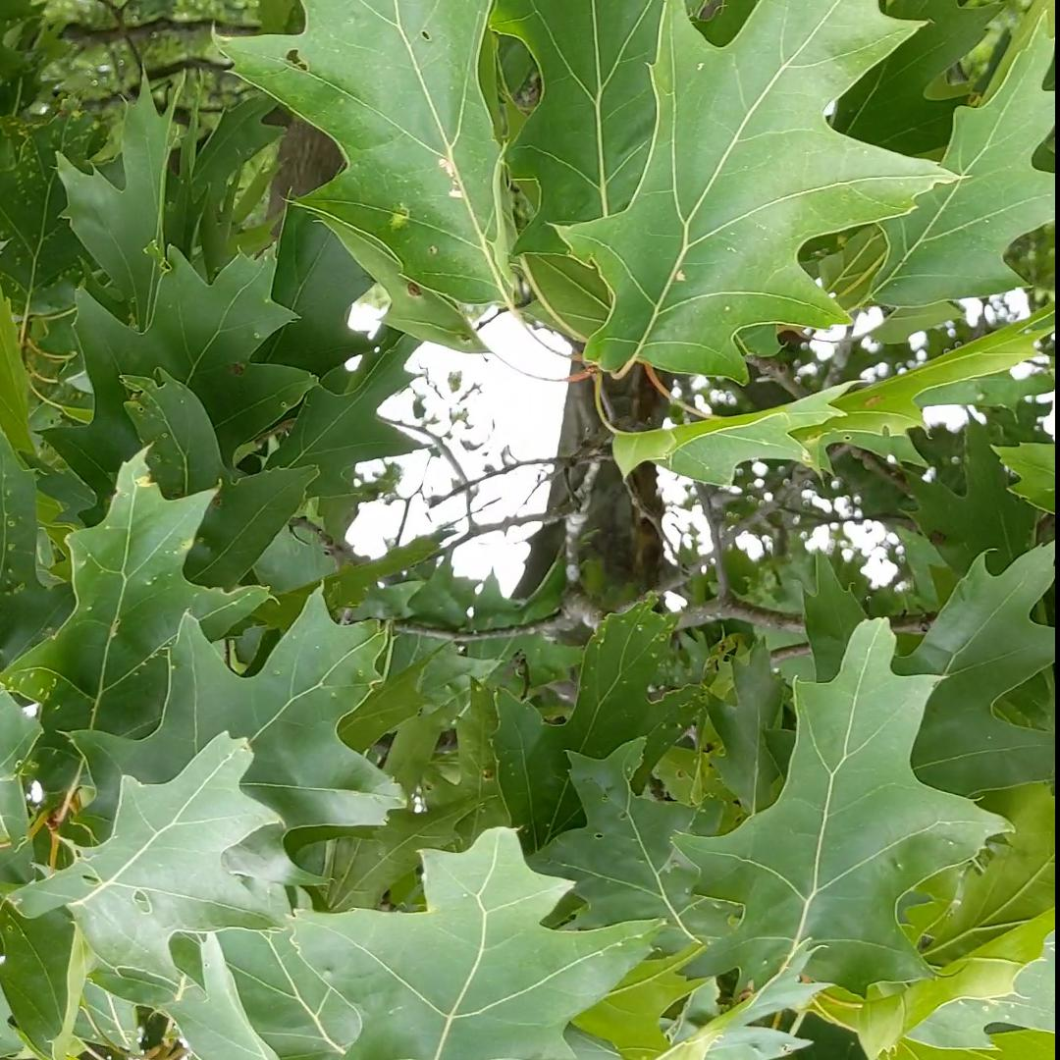
Augmentations
Notes:
Data wrangling steps and key takeaways (1-2 slides)
Show examples

Slide 14
16 videos
7000 final images
~2800 raw images

Slide 15
Final Model
Deep learning model (CNN)
Pre-trained model - DenseNet169
Over 12 million parameters
30 minutes of training
Notes:
The formulation of the project as a data science problem and a description of the dataset (1-2 slides)

Slide 16
Presentation Outline
Problem
Model and Data
Results
Recommendations and Future Work

Slide 17
Results?
Accuracy of 98%
!
Notes:
Analysis results (1-2 slides)

Slide 18
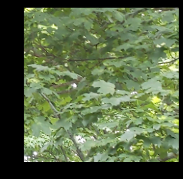


Slide 19
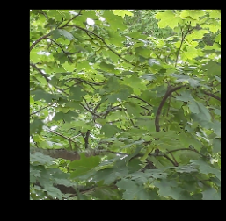


Slide 20
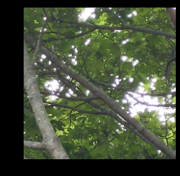

Slide 21
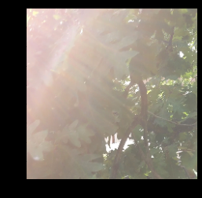

Slide 22
Presentation Outline
Problem
Model and Data
Results
Recommendations and Future Work

Slide 23
Recommendations
Use model to identify leaf as maple or oak with high confidence
Take image up close – within a couple feet
For best results, take video and input hundred images – near 100% accuracy
Notes:
Recommendations for your client based on your results (

Slide 24
Future Work
#1
Identify model’s specific weaknesses
Notes:
Practical considerations, suggestions for improvement, and future work (1

Slide 25
Future Work
#2
Create multi-class classifier
Specific species of maple, oak
Different species of trees
Notes:
Practical considerations, suggestions for improvement, and future work (1

Slide 26
Future Work
#3
Wider range of images
Up-close, tree as distance
Lighting
Poor angles and occlusion
Notes:
Data wrangling steps and key takeaways (1-2 slides)
Show examples

Slide 27
Future Work
#4
Train all parameters (unfreeze the model)
Or build a model from scratch!
Notes:
Data wrangling steps and key takeaways (1-2 slides)
Show examples

Slide 28
Thank you!
Questions?

